Slide 1
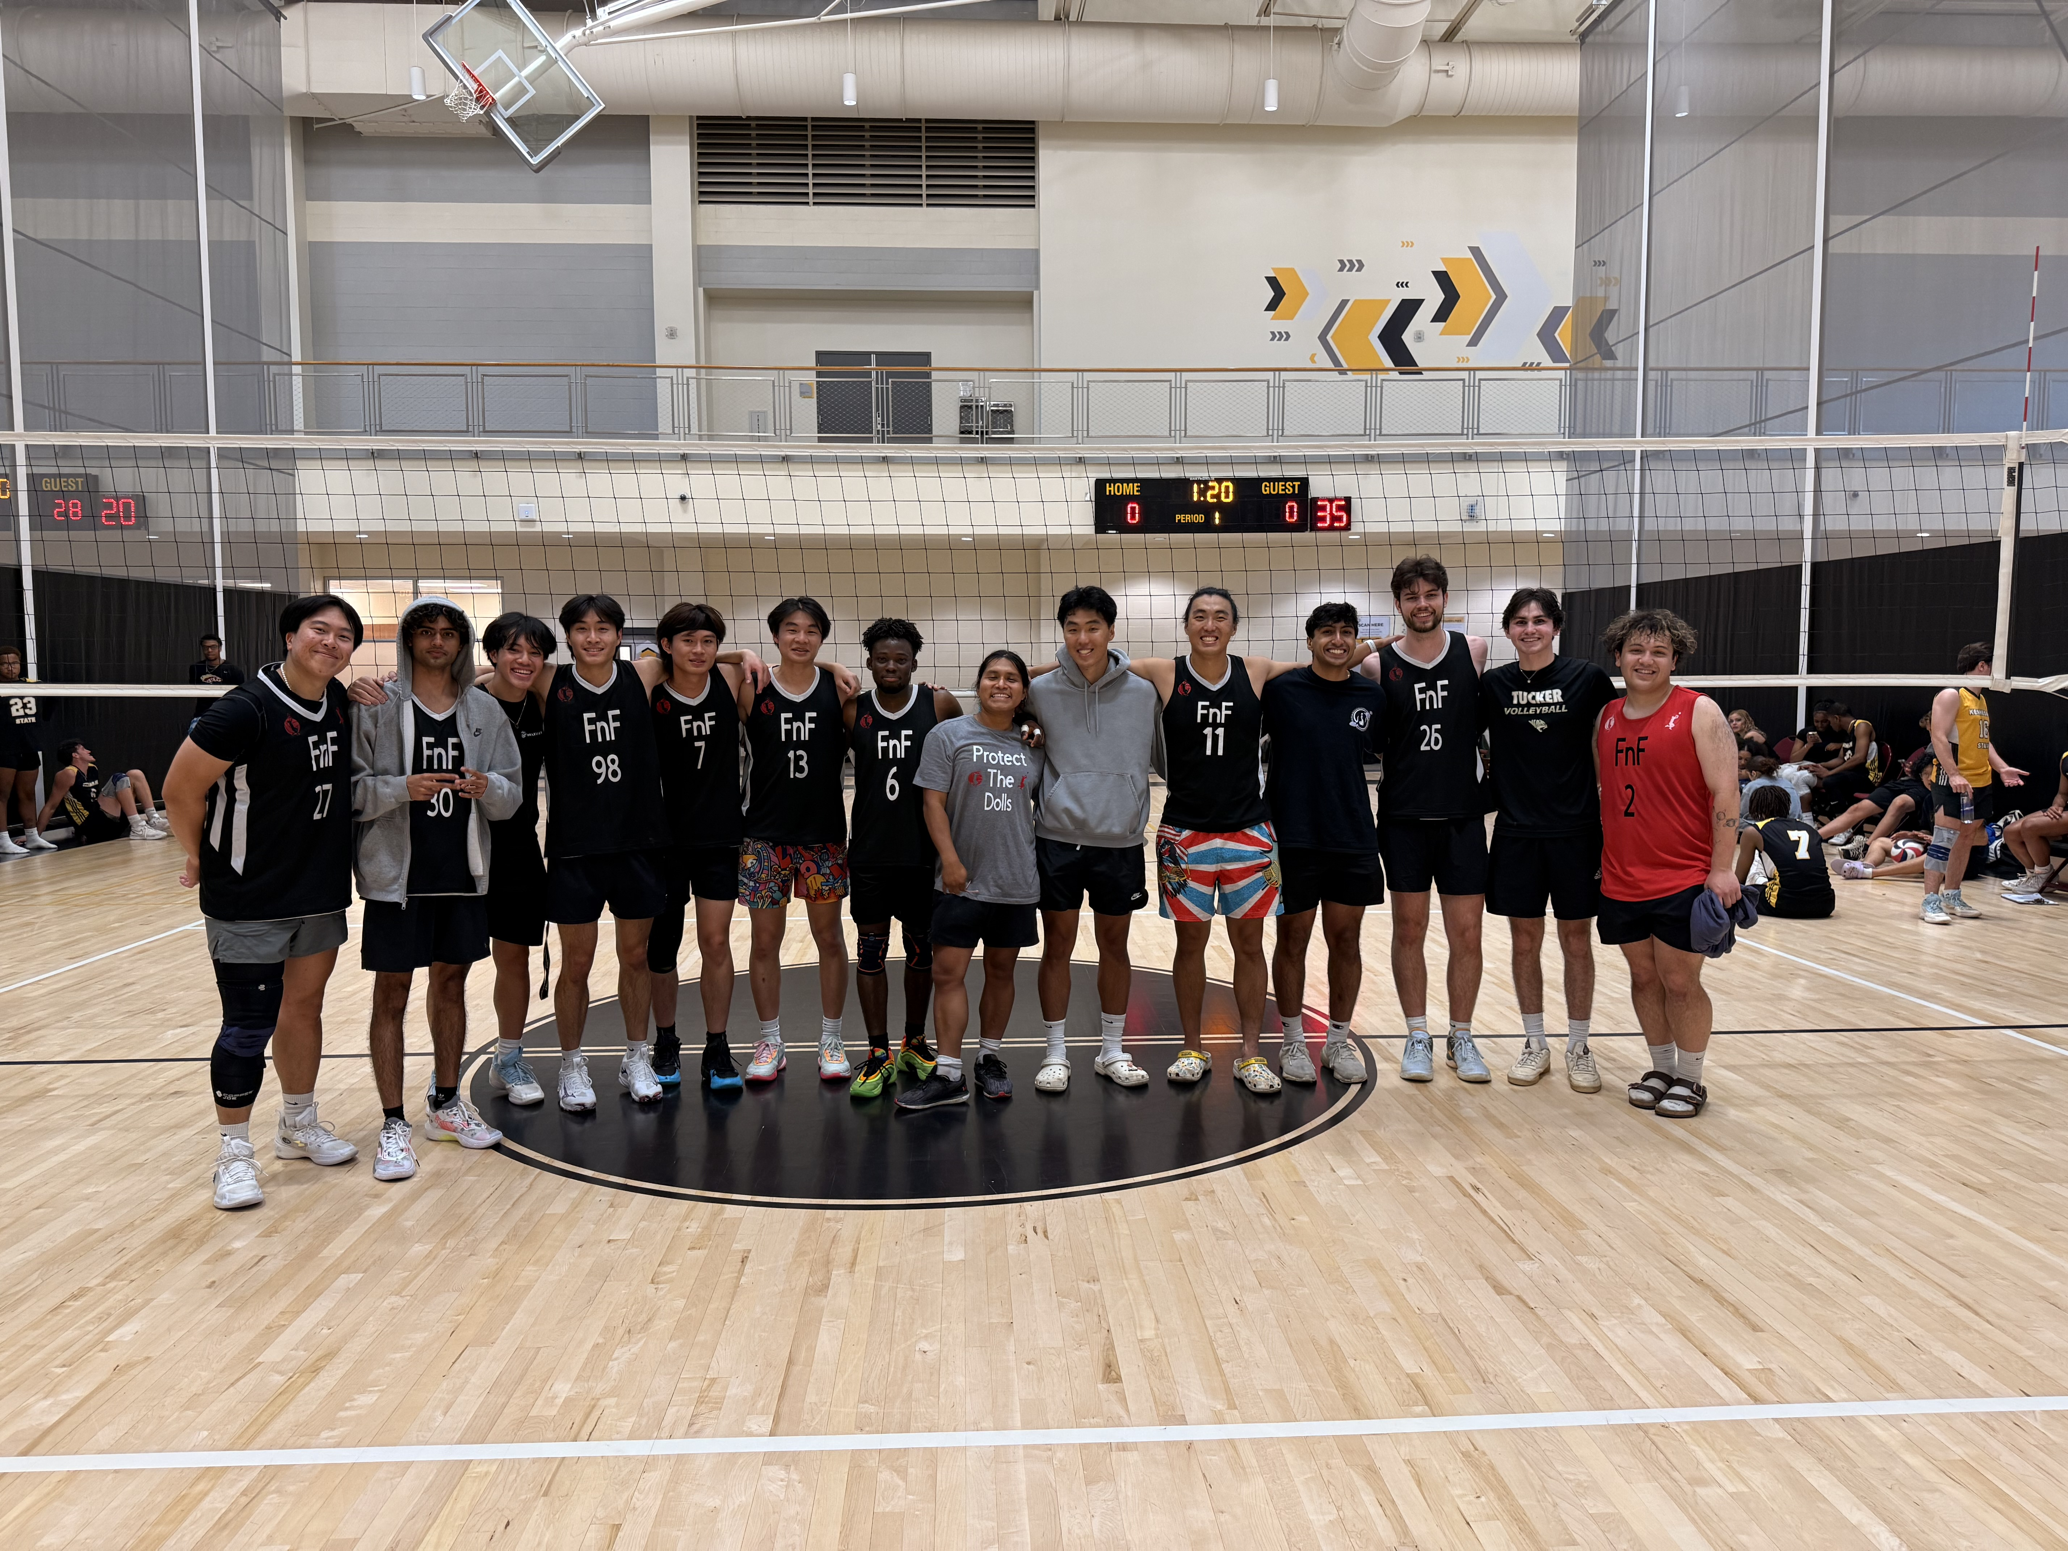
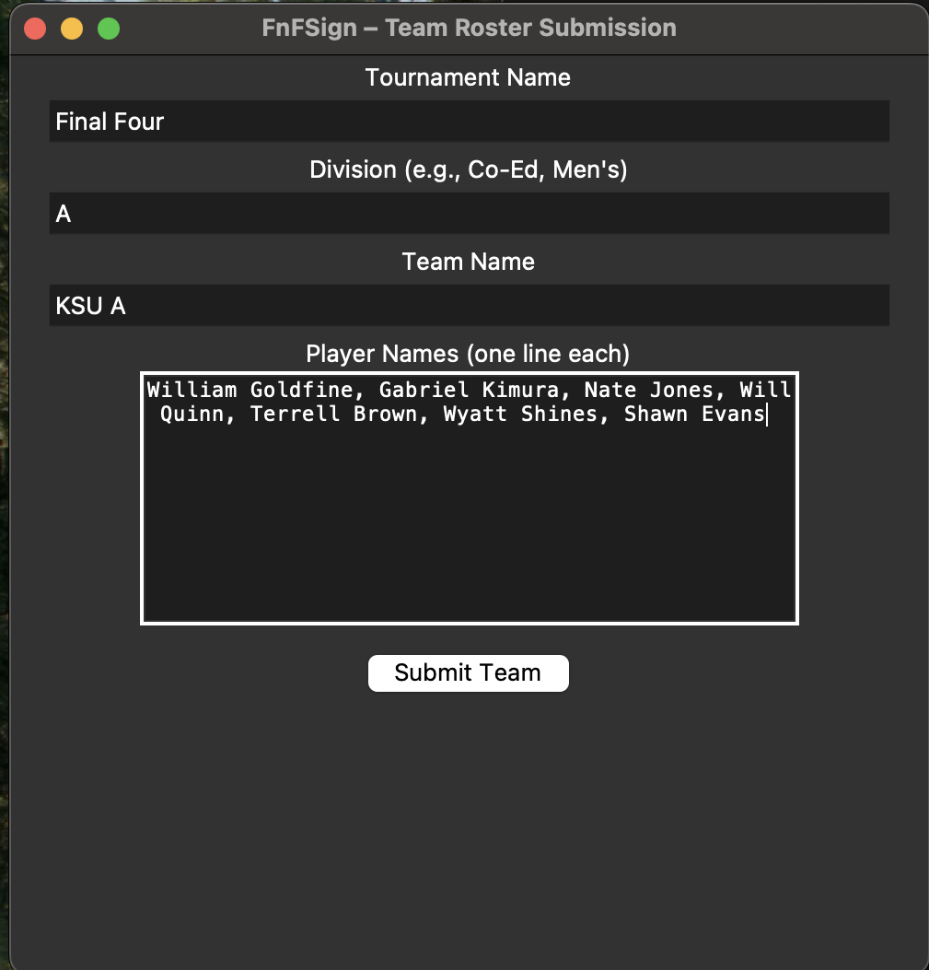
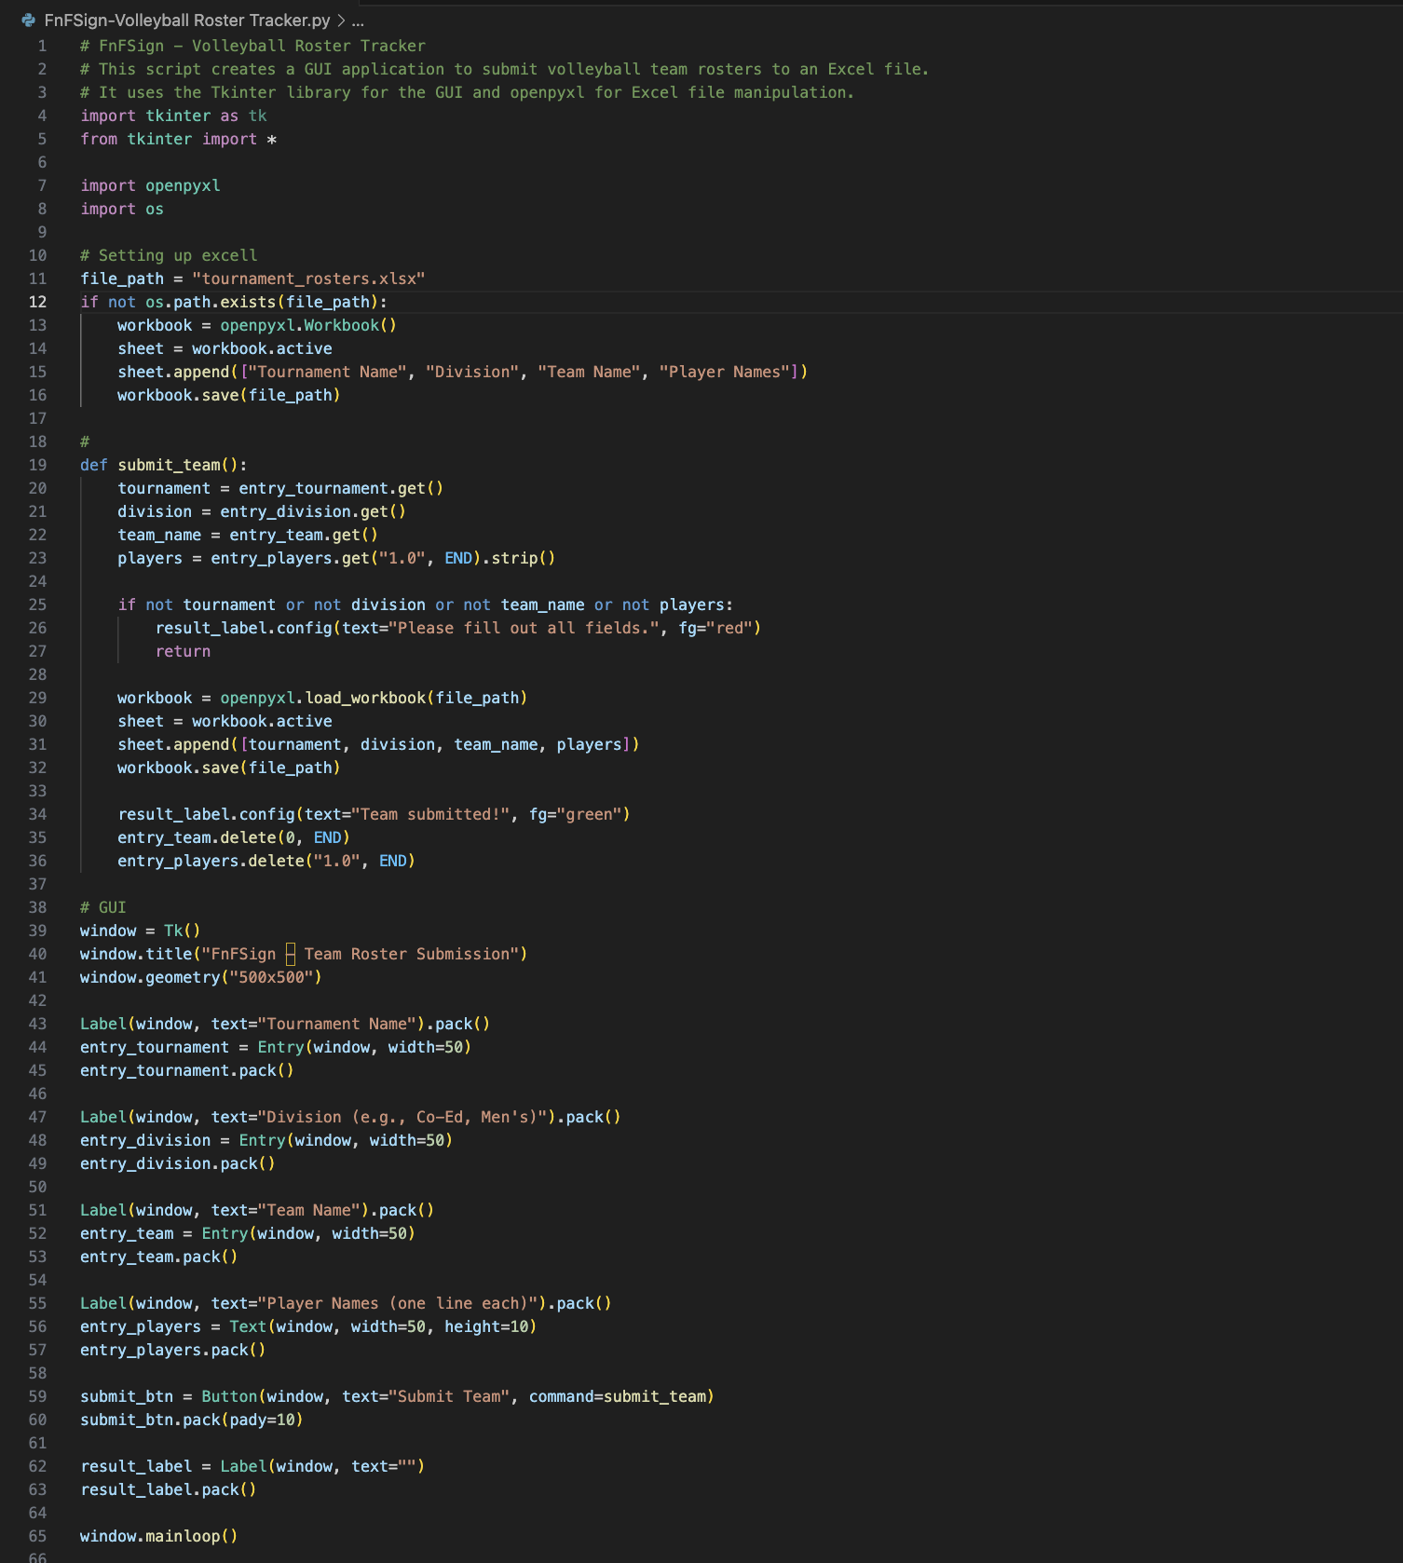
FnFSign- Volleyball Roster Tracker
“Simple tournament team entry with Excel export for local volleyball events.”
Tech Used:
Python, Tkinter, OpenPyXL
Main Features:
Easy team registration
Save to Excel
Great for small tournament organizers
Franller Castellano

